Slide 1
WOMEN’S SELF-DEFENSE

Slide 2
Agenda
1. Introductions
- Identifying Your Purpose
- Our Brains During Trauma
2. Demonstration I
3. Our Brains After Trauma
- What to Do After Trauma
4. Demonstration II
5. Safety Planning
- Internal & External Planning
- Red Flags
- Internal & External Crisis Resources
6. Demonstration III/Coping Skills/Inquire
Please participate at your comfort level, education and/or demonstrations, you are welcome to show up however you are in this moment!

Slide 3
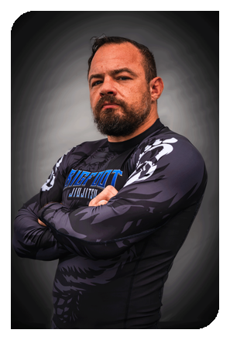
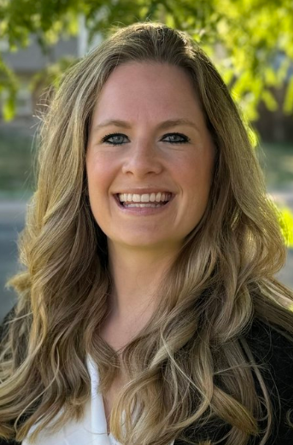
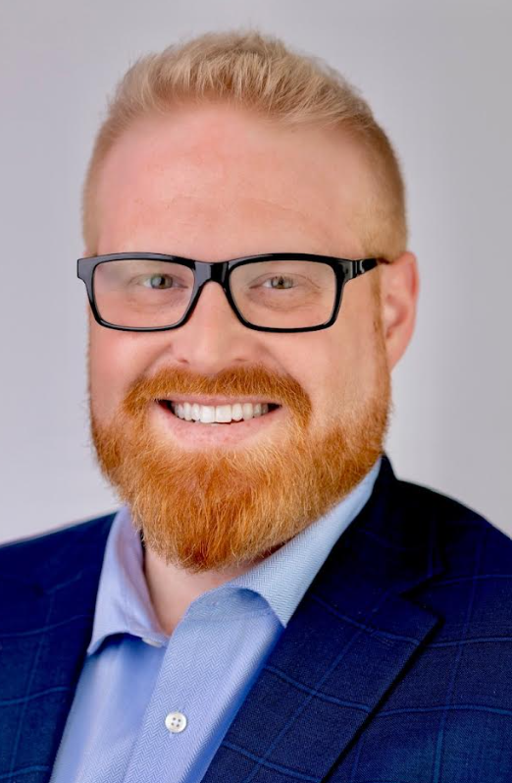
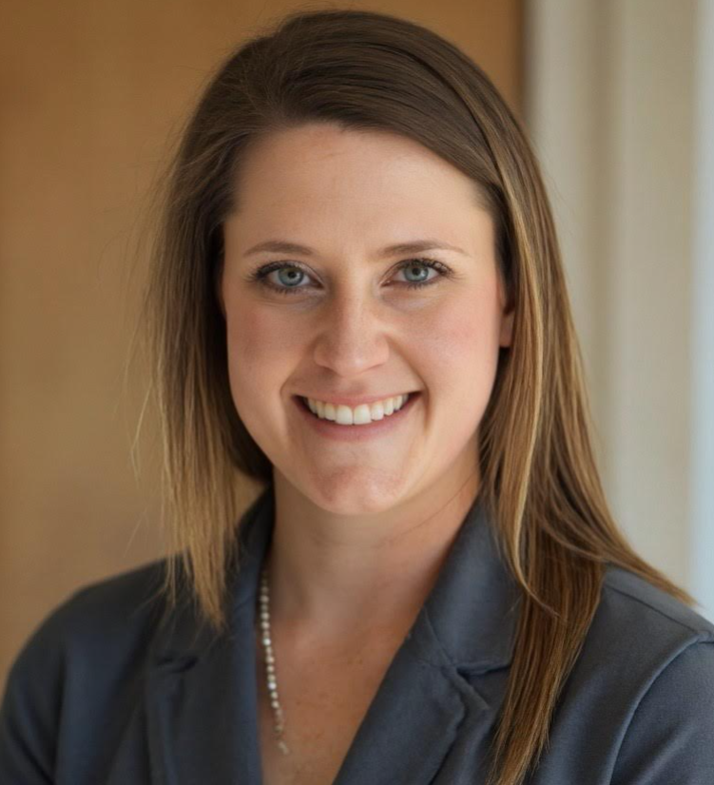
Instructors
Blane Sibille
Head Coach Bigfoot Jiujitsu
Jessica Schiefelbein, LCSW
Conifer Counseling Trauma Clinician
Katie Chapin, Clinical Student
Colorado Christian University
Angela Sibille
Assistant Coach Bigfoot Jiujitsu
Benjamin Bunte, Clinical Student
Adams State University
Vince D’Orio
Assistant Coach Bigfoot Jiujitsu
Britney Schroeder, Clinical Student
Adams State University

Slide 4
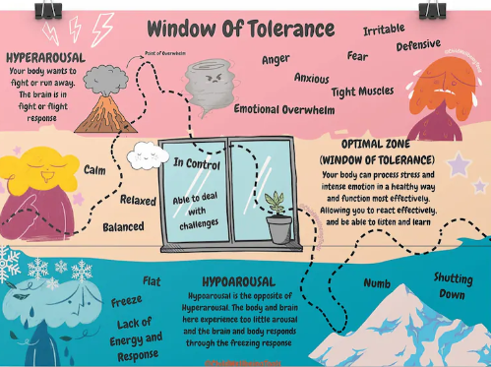
Reason & Mindfulness
Perspective
- Have you experienced physical/emotional violence?
- Know someone who has experienced physical/emotional violence?
- Are you wanting more education and support for yourself and community?
- What is your window of tolerance?
Mindful of Self & Space
- “Tap-Out” anytime
Safe Word- “Moose”
Realism
10% of information is retained in a single seminar or meeting
Repetition and continued education of this content is key

Slide 5
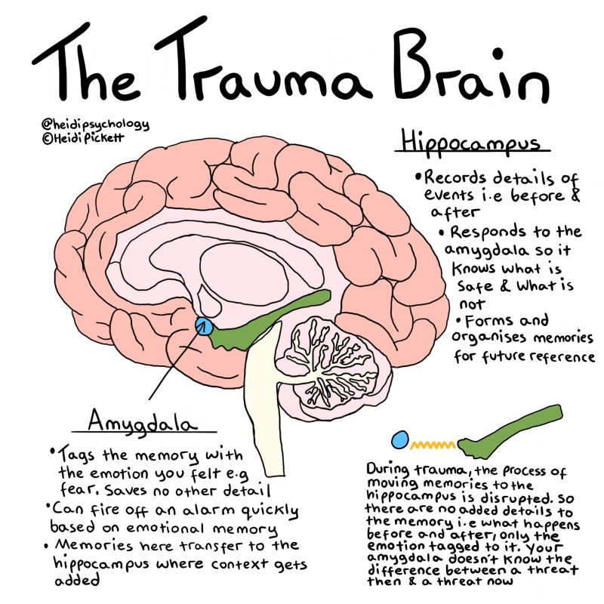
Our Brains During Trauma

Slide 6
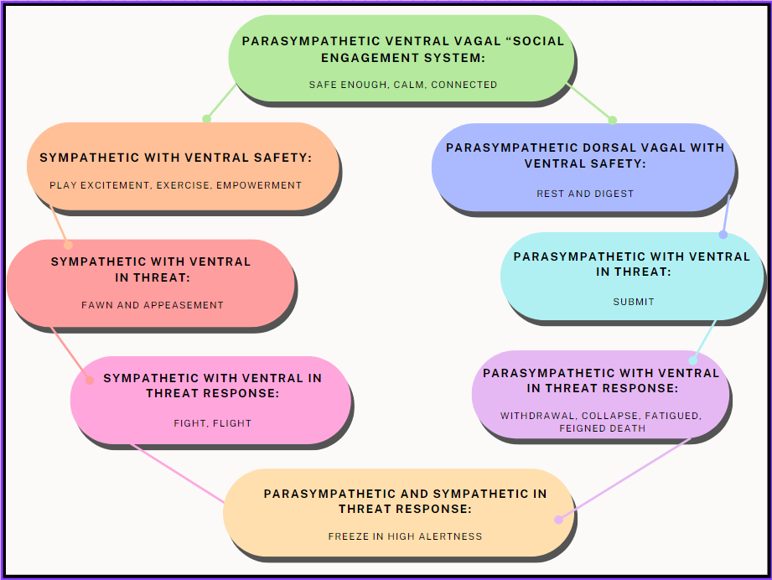
Trauma Engagement

Slide 7
Trauma Engagement
Adaptive Survival Strategies The Defense Cascade (Kozlowska, et al. 2015)
Freeze | Flight | Fight | Fawn | Submit | Faint
Tonic Immobility Increased heartrate Feeling frozen, cannot move – Breath is held Deer in the headlights Eyes are locked or still Hyper aware of body sensations | Startles easily Hyper-vigilant Breathing rapidly into upper chest Eyes darting Racing thoughts Jumpy or fidgeting Difficulty slowing down or connecting to the body | Tension in jaw, arms, hands, legs Audible breath, exerted exhale Aggressive posturing Furrowed brow, eyes narrowed Can’t relax in body | Highly aware of other’s somatic cues Posture leans forward, chin forward Eyes reaching or scanning Caretaking or co-dependence Disconnected from own body or needs | Focused on attachment even if to the perpetrator Surrender a will of one’s own Longing to belong Loss of a “sense of self” Hunched shoulders Dulling of the senses | Collapsed Immobility Reduced heartrate Eyes downcast Breath is shallow Nausea, dizziness, blurred vision Disgust, lips curled down Numbness, disconnected from body
81% of women in the United States have experienced some form of sexual harassment or assault in their lifetime.
Most of this violence is intimate partner violence. Worldwide, almost one third (27%) of women aged 15-49 years who have been in a relationship report that they have been subjected to some form of physical and/or sexual violence by their intimate partner.
Factors like the attacker's behavior, the environment, the victim's perception of their own ability to fight back, and their level of fear can influence how a woman responds to an attack.
Notes:
https://www.nsvrc.org/statistics
https://www.who.int/news-room/fact-sheets/detail/violence-against-women
https://www.ojp.gov/ncjrs/virtual-library/abstracts/fighting-back-womens-resistance-rape

Slide 8
Grounding….What is it Good For?
2 minutes a day, for 6 weeks, our bodies automatically begin to practice our habits
Frontal Lobe Control
Enhances Decision Making
Increases Emotional Regulation
Builds Resilience
Increased Self-Awareness
5 Senses Coping Skill Practice

Slide 9
Scenario & Demonstration I

Slide 10
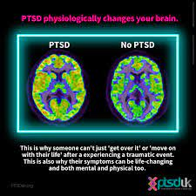
Our Brains After Trauma
When someone experiences a traumatic event or experiences extreme fear, brain chemistry is altered and the brain begins to function differently--this is called the "Fear Circuity" and it is a protective mechanism which we all have inside of us.
The brain does not encode memories in chronological order, there are gaps in memory, and whatever the "fear circuitry" in the brain focused attention on during the assault is more likely to be encoded into memory than periphery details.
Notes:
https://www.unco.edu/assault-survivors-advocacy-program/learn_more/neurobiology_of_trauma.aspx

Slide 11
What to do after a trauma…
Ensure Safety
Re-ground
Identify Environment- 5 senses
Muscle Tension Relaxation
Breathing – box breaking, finger breathing, 4-7-8
Locate Help
Write or Verbalize Attack
Identify Your Emotions and Thoughts
How am I feeling? – “Name it to Tame It”
What do I need?
Who do I need?
Identify Continuous Coping
Notes:
https://www.unco.edu/assault-survivors-advocacy-program/learn_more/neurobiology_of_trauma.aspx

Slide 12
Resources
Internal 5Cs
Capacity Coping Skills Community Connections Communication
External
9-1-1
Non-Emergent 24 Hour Hotlines
Paragon On-Call Therapist 303-953-0117
Colorado Crisis Services 844-493-8255
National Domestic Violence Hotline 800-799-7233
Local Shelters
Peace Works 303-838-7176
info@peaceworksinc.co
24/7 Safeline: 303-838-8181

Slide 13
Scenario & Demonstration II

Slide 14
Safety Planning - 5cs Capacity Coping Skills Community Connections Communication
Capacity- know your ability and inability
Coping Skills- 2 minutes a day can increase the mind/body presence
Community- who are your safe places and confidants
Connections- know your connections and safety plan
Communication- surrounding ourselves with safe individuals and normalize talking about violence and safety
Notes:
My directive is to go over the PDF Safety Plan intermediately along with impromptu above subject matter

Slide 15
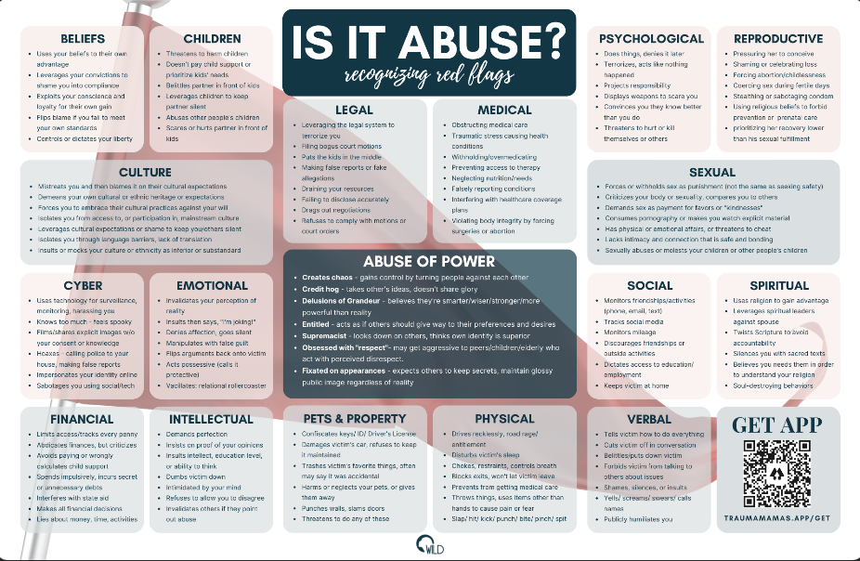
Recognize Red Flags

Slide 16
MAKE and BE the Change
#MeToo movement
Tarana Burke founded the #MeToo movement in 2006 to support survivors of sexual violence.
Increased awareness
The UNiTE campaign is a 16-day initiative that raises awareness about violence against women and girls.
Equality Now works to increase awareness and draft laws that protect victims.
Other efforts
Investing in women's education and empowerment can help build more resilient communities.
Holding perpetrators accountable can help end violence against women.
Increasing funding to women's rights movements can help end violence against women.

Slide 17
Resources
Internal 5Cs
Capacity Coping Skills Community Connections Communication
External
9-1-1
Non-Emergent 24 Hour Hotlines
Paragon On-Call Therapist 303-953-0117
Colorado Crisis Services 844-493-8255
National Domestic Violence Hotline 800-799-7233
Local Shelters
Peace Works 303-838-7176
info@peaceworksinc.co
24/7 Safeline: 303-838-8181
- https://www.wildernesstowild.com/is-it-abuse

Slide 18
Coping Skill Join us for continued coping skill building or participate in the 3rd Demonstration
Notes:
I am going to demonstrate another collective grounding skill then offer a breakout

Slide 19
Scenario & Demonstration III
Notes:
For Demo 3 I was going to leave this open for individuals who wished to speak about mental health on the side, while you demonstrate another scenario for those who wish.

Slide 20
Resources
Internal 5Cs
Capacity Coping Skills Community Connections Communication
External
9-1-1
Non-Emergent 24 Hour Hotlines
Paragon On-Call Therapist 303-953-0117
Colorado Crisis Services 844-493-8255
National Domestic Violence Hotline 800-799-7233
Local Shelters
Peace Works 303-838-7176
info@peaceworksinc.co
24/7 Safeline: 303-838-8181

Slide 21
Thank you

